Slide 1
Corporate Social Responsibility: Looking at EHS and Sustainability Issues Outside the Box Matt Conway CHMM, CSP Environmental Compliance Assistance for Business & Industry Seminar
October 29, 2019

Slide 2
PING, Inc.
Disclaimer
The content in this presentation is meant for educational purposes only. It is not intended as legal advice or guidance. All organizations are unique in their operations and circumstances. You should consult the advice of your advisors prior to implementation of your own programs.

Slide 3
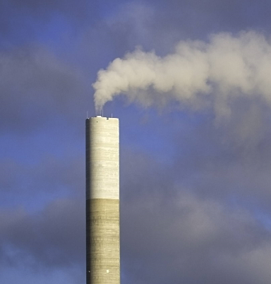
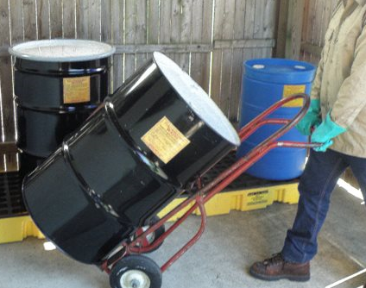
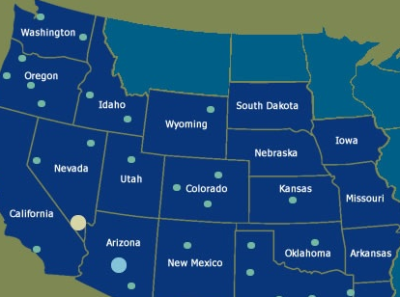
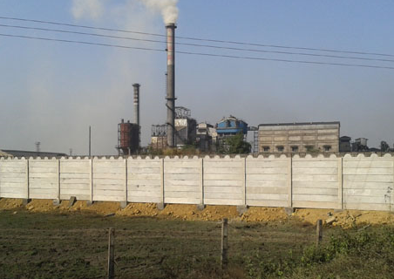
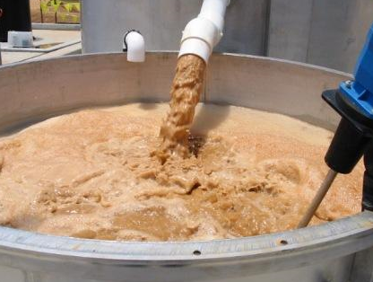
Traditional EHS Role
Images from internet open sources

Slide 4
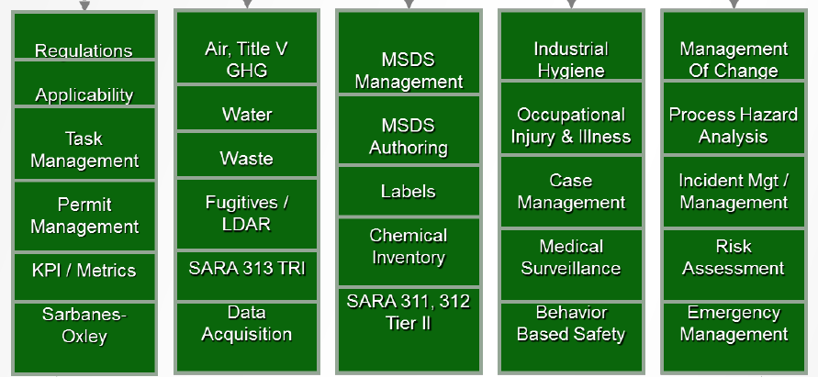
Traditional EHS Role
Images from internet open sources

Slide 5
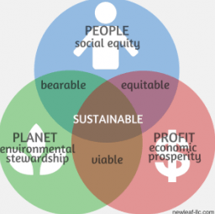
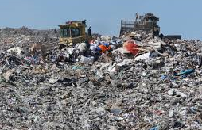
Sustainability
Images from internet open sources

Slide 6
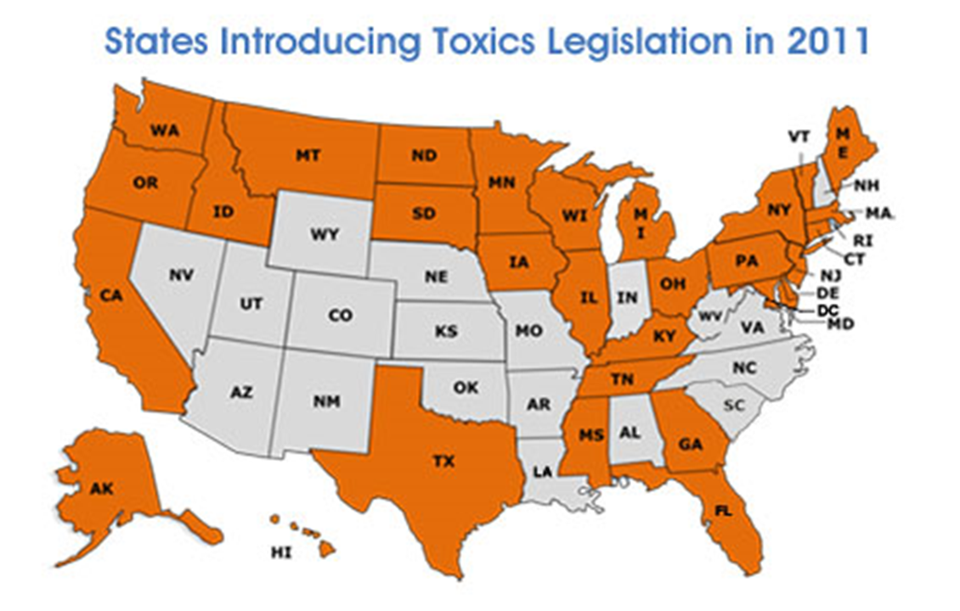
New Challenges
Images from internet open sources

Slide 7
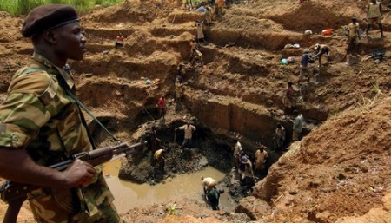
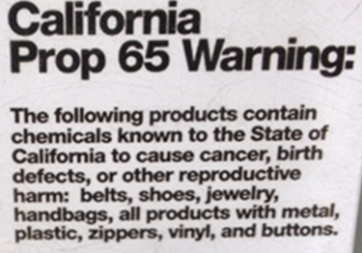
New Challenges
Images from internet open sources

Slide 8
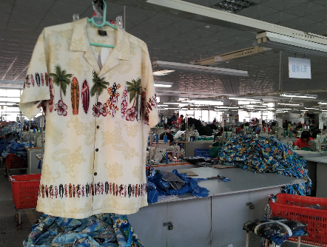
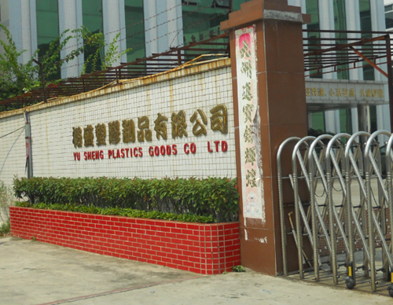
New Challenges
Images from internet open sources

Slide 9
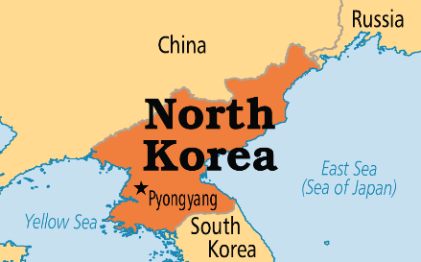
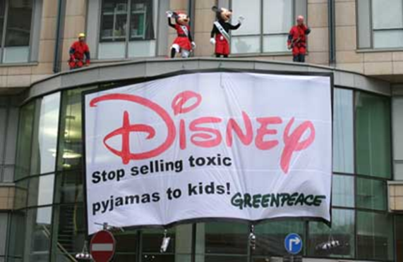
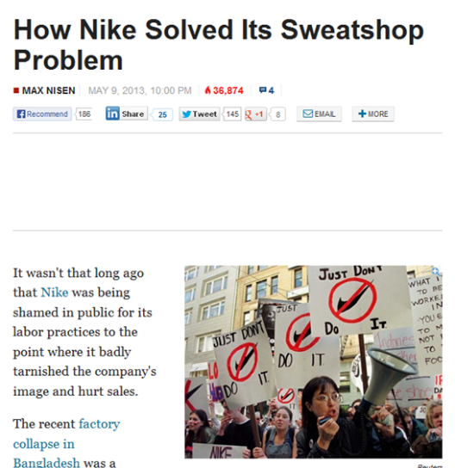
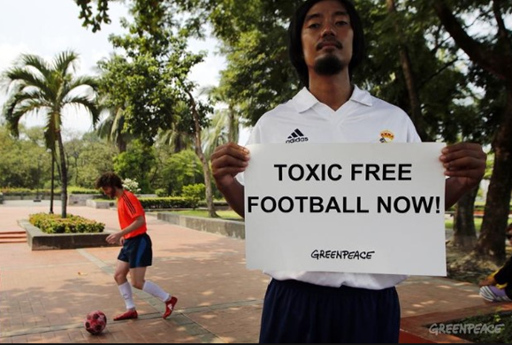
New Challenges
Images from internet open sources

Slide 10
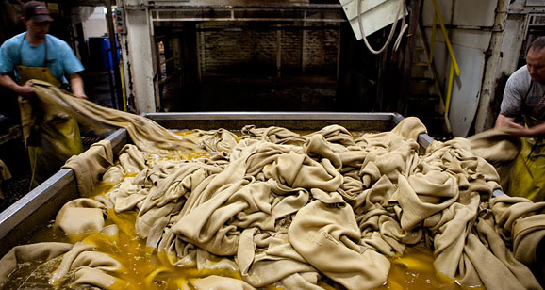
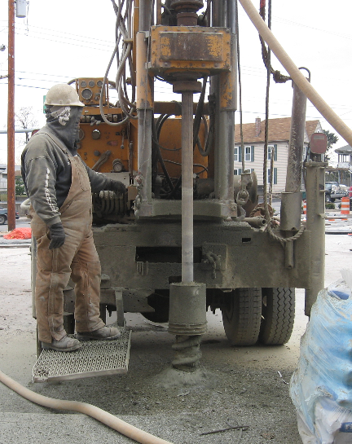
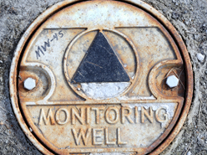
Are these new challenges EHS Issues?
Leather Tanning
Cr(III) may oxidize to Cr(VI)
http://www.ncbi.nlm.nih.gov/pmc/articles/PMC2883401/
https://www.drapersonline.com/business-operations/can-the-modern-slavery-act-solve-fashions-ethical-crisis/7018407.article
Images from internet open sources

Slide 11
Corporate Social Responsibility
Corporate social responsibility is the continuing commitment by businesses to behave ethically and contribute to economic development while improving the quality of life of the workforce and their families as well as of the local community and society at large.
The World Business Council for Sustainable Development
CSR is a concept with many definitions and practices. The way it is understood and implemented differs greatly for each company and country. Moreover, CSR is a very broad concept that addresses many and various topics such as human rights, corporate governance, health and safety, environmental effects, working conditions and contribution to economic development. Whatever the definition is, the purpose of CSR is to drive change towards sustainability.
Financial Times
Corporate social responsibility is nothing but maximizing the value of your company over a long period of time, because in the long term, social and environmental issues become financial issues.
Lars Sorenson – Novo Nordisk

Slide 12
https://www.slideshare.net/RobbySahoo/corporate-social-responsibility-13975540

Slide 13
Does CSR fit?
Images from internet open sources

Slide 14
CSR Program
Legal Compliance
Child Labor
Forced Labor
Environment (includes chemical use)
Health and Safety
Wages and Benefits
Nondiscrimination
Hours of Work
Harassment
Association
Anti-Corruption
Images from internet open sources

Slide 15
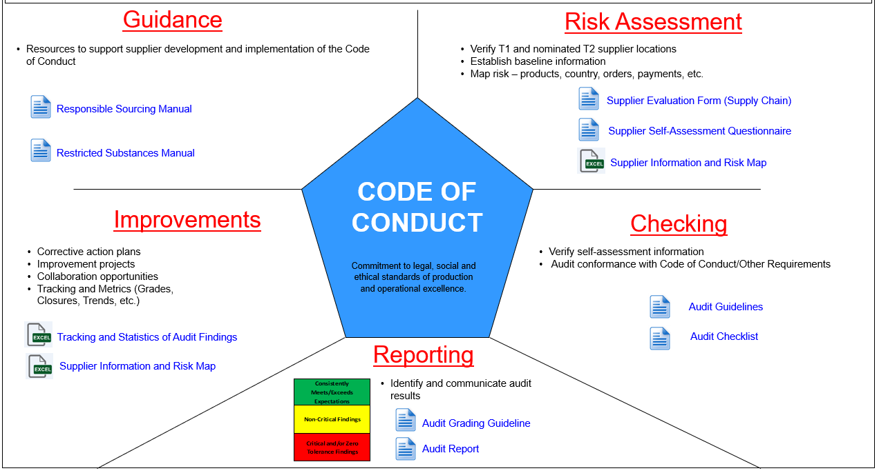

Slide 16
Guidance

Slide 17
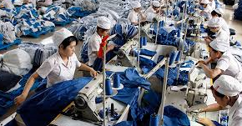
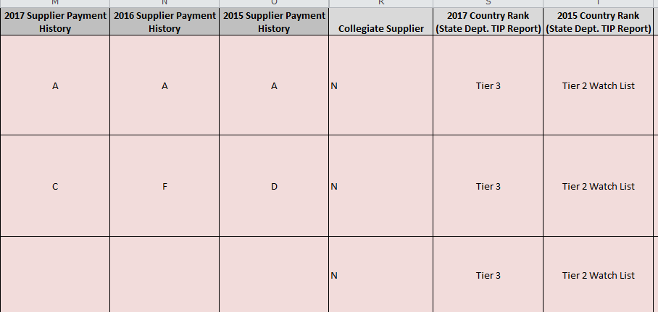
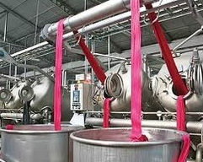
Risk Assessment
Country
Industry
Product Type
Accounts Payable
Volume of Production
Self Assessment
Images from internet open sources

Slide 18
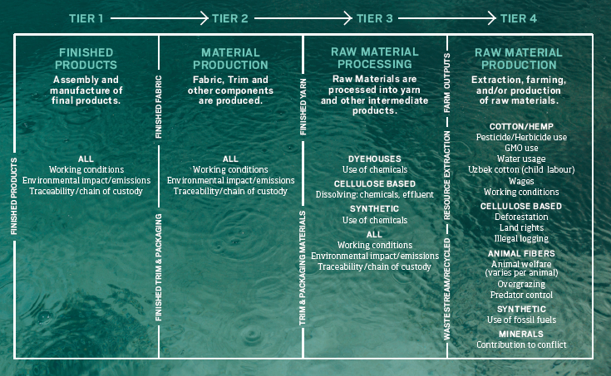
Outdoor Industry Association

Slide 19
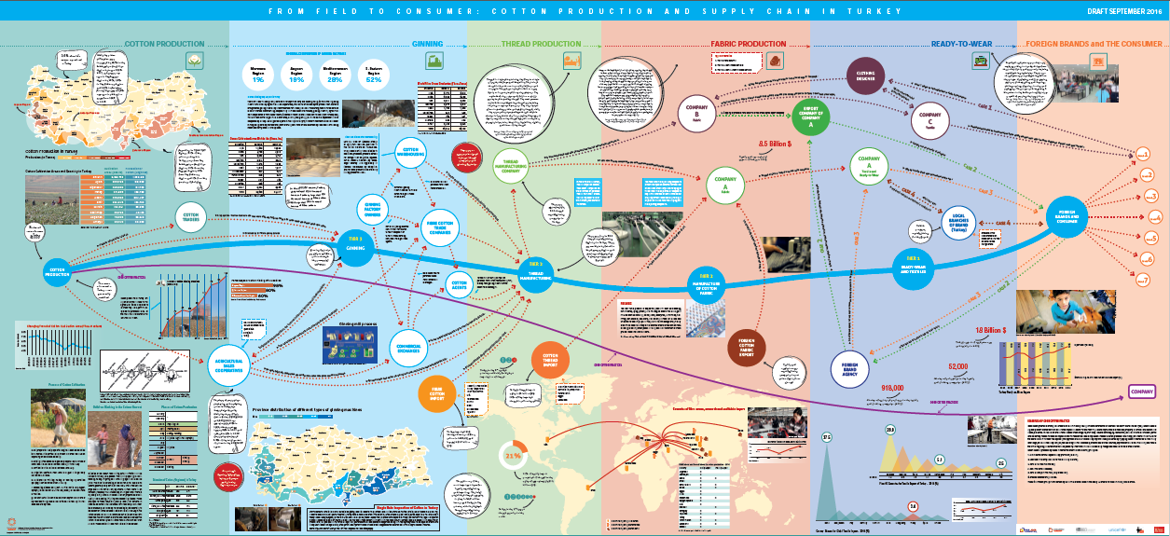

Slide 20
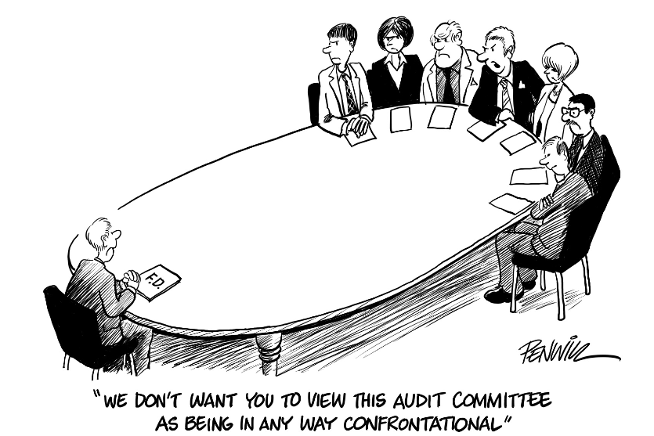
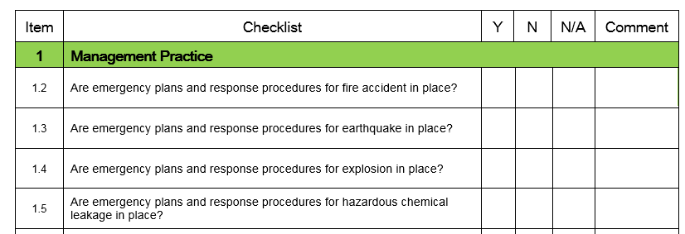
Checking
Images from internet open sources

Slide 21
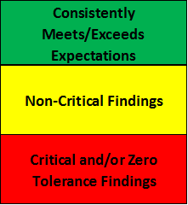
Reporting
Clearly Define
https://colliervillehs.colliervilleschools.org/apps/pages/index.jsp?uREC_ID=279595&type=d&pREC_ID=630976
Images from internet open sources

Slide 22
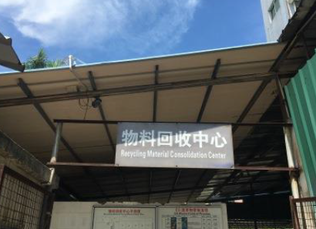
Improvements
Images from internet open sources

Slide 23
Restricted Substances – What?
Images from internet open sources

Slide 24
Restricted Substances – Where?
Hat Shaping
Formaldehyde
http://www.afirm-group.com/presentations/2007/Frazier%202007%201.pdf
Images from internet open sources

Slide 25
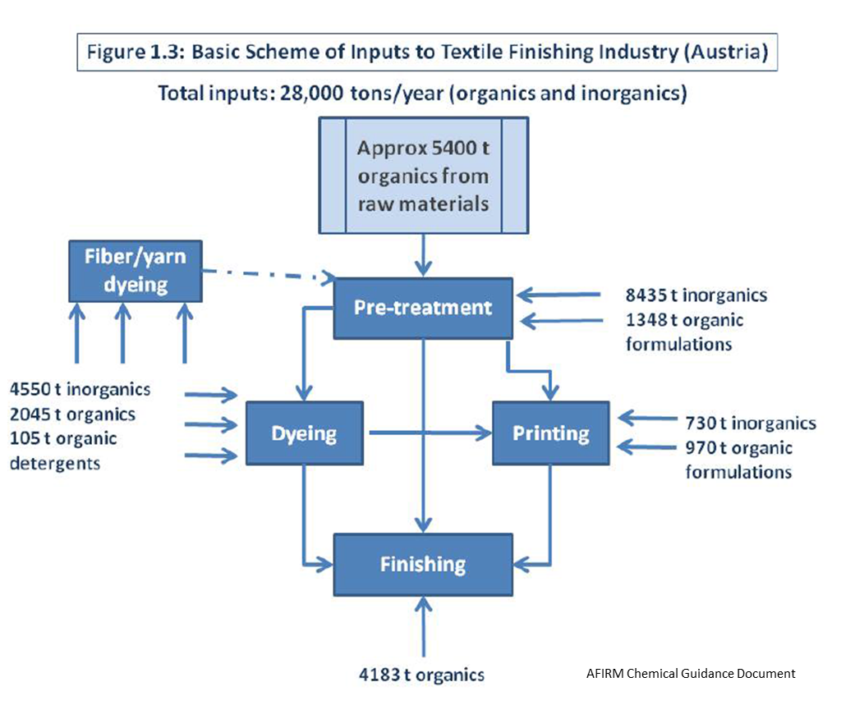
Restricted Substances – How?

Slide 26
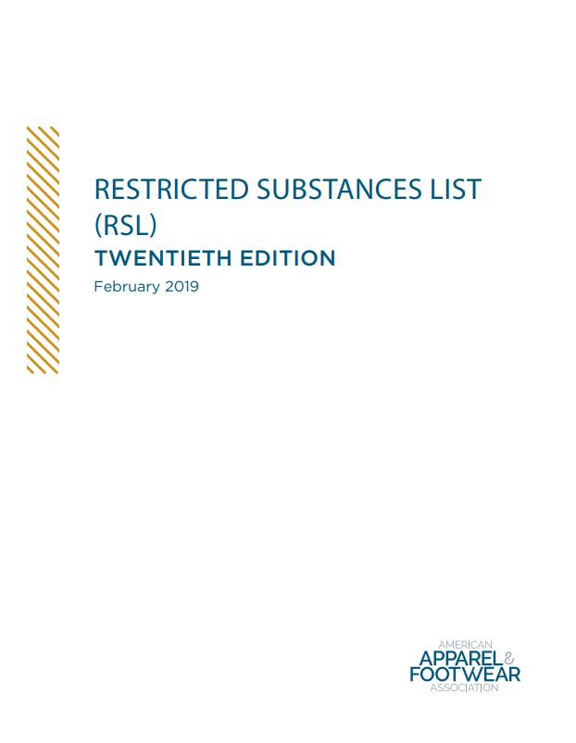
Restricted Substances - Control
Images from internet open sources

Slide 27
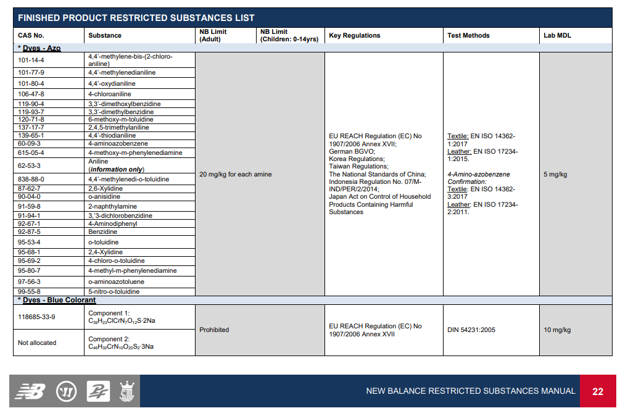
https://www.newbalance.com/responsible-leadership/product.html#rs
Images from internet open sources

Slide 28
Restricted Substances - Control

Slide 29
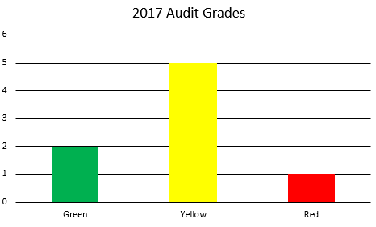
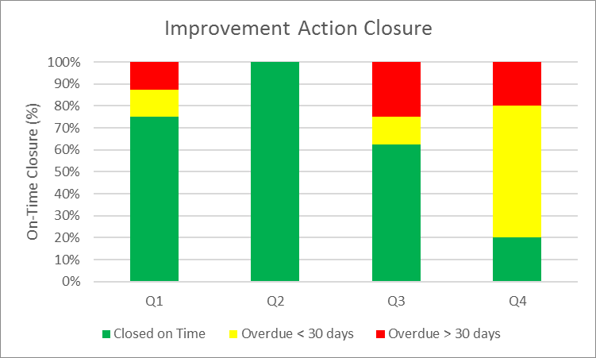
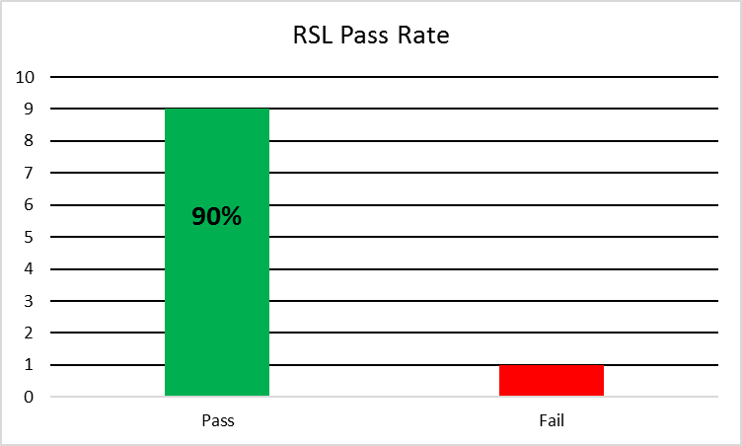
Metrics/KPIs
Examples
Not Real Data
Notes:
Metrics-
Observe trends, ID areas for improvement. Maybe target activities to help improve issues with Hours of Work
Develop key performance indicators and meaningful metrics that measure results – not just activities. For example, maybe set a KPI for 100% timely closure of improvement actions or a 100% RSL Pass Rate.

Slide 30
Education and Mentoring
Mentoring Organizations
Example CSR Programs: Factory Wastewater
Images from internet open sources

Slide 31
Images from internet open sources

Slide 32
THANK YOU Matt Conway CHMM, CSP

